Slide 1
Lensy
Julija Pettere, Max Ding, Amy Shah
Notes:
JULIA

Slide 2

Design Problem
Meet Sara...
…
Overall Problem
Notes:
JULIA (1 min)
Personal story about Sara

Slide 3
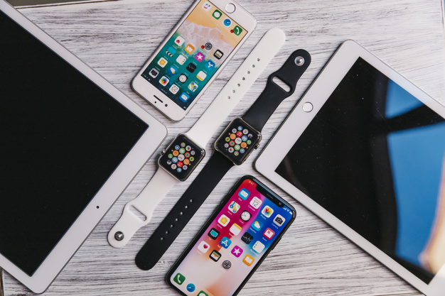
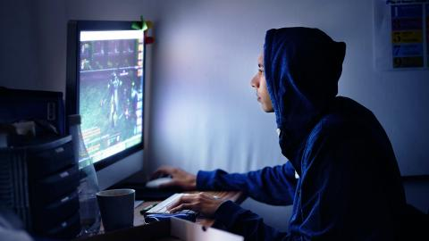
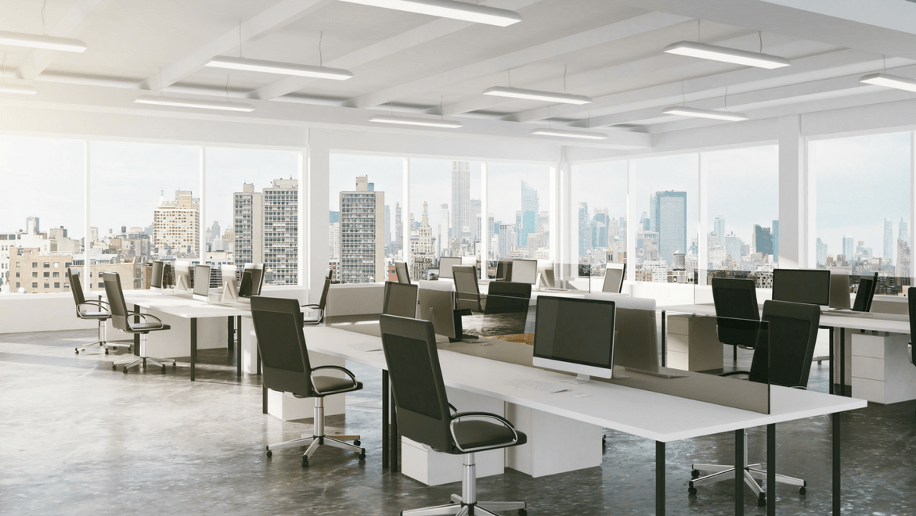
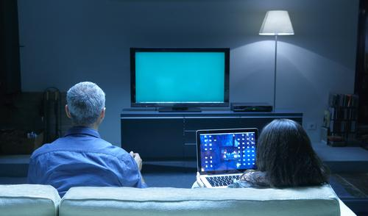
Research Interviews
5 participants with varying:
Knowledge of digital eye strain (DES)
Work environments
Focus levels
Concern about eye strain symptoms
Number of devices used
…
Design Research
Notes:
AMY (30 sec)
We conducted interviews with individuals who spend several hours every day looking at screens for school/work related reasons. We tried to cover a range of participants and environments in order to understand the variety of factors that contribute to digital eye strain, why individuals cannot/do not do anything to relieve their symptoms and where our greatest opportunity to help is. This range included those who work in brighter/darker environments, those who are concerned about their digital eye strain/those who are not, those who work at 1-2/3+ devices a day, and those who are/are not knowledgeable about digital eye strain and existing helpful methods to reduce symptoms. The participants were:
Participant #1: Senior Engineer Manager @ large tech company
Environment: Open shared office space with lots of natural lighting/sometimes glare
Participant #2: Student in university CSE program
Environment: Works mostly on her bed in the dor,/ shared spaces in CSE building in evenings so usually dimmer lighting
Participant #3: stay at home mother/takes classes at community college
Environment: Work space in various rooms at home during the day with lots of natural lighting
We chose interviews as they gave us the best glimpse into an individual’s environment and pain points, and worked well with our time restrictions. By asking the right questions, we found participants would go on small rants that ended up being extremely insightful. Our interviews provided us with interesting and unique themes to work off of.

Slide 4
Key Findings
Participants with digital eye strain (DES) often:
Participants are looking for a highly customizable solution that fits with varying schedules, environments, and current eye health
Are unfamiliar with digital eye strain
Forget to take actions that help reduce symptoms
Have no motivation to take action
…
Design Research
Notes:
AMY (30 sec)
We observed that digital eye strain is often developed subconsciously and over time via extensive use of technology devices. We found especially those not in the tech industry were less informed about digital eye strain and its effects, whereas those in the industry did not have time because of stress and looming deadlines to actively take measures to prevent the symptoms from worsening.
Many participants are not aware of causes, prolonged effects, of DES but wish to understand DES and it symptoms related to their personal eye health
Since many participants feel like they forget to take actions are too busy they need motivation and some form of reminders to drive discipline
Participants are looking for a highly customizable solution that fits with their schedules and needs
Some want daily reports
Some do and some do not want reminders
Some want something they can mute whenever
Some want things to run in the background as much as possible while others want recommended exercises/actions

Slide 5
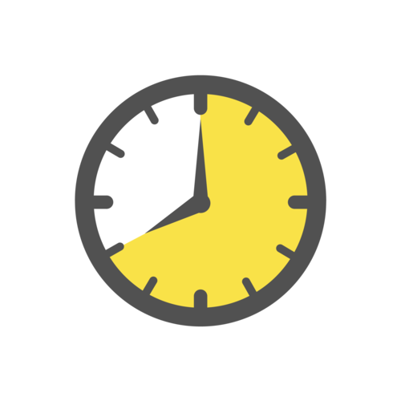



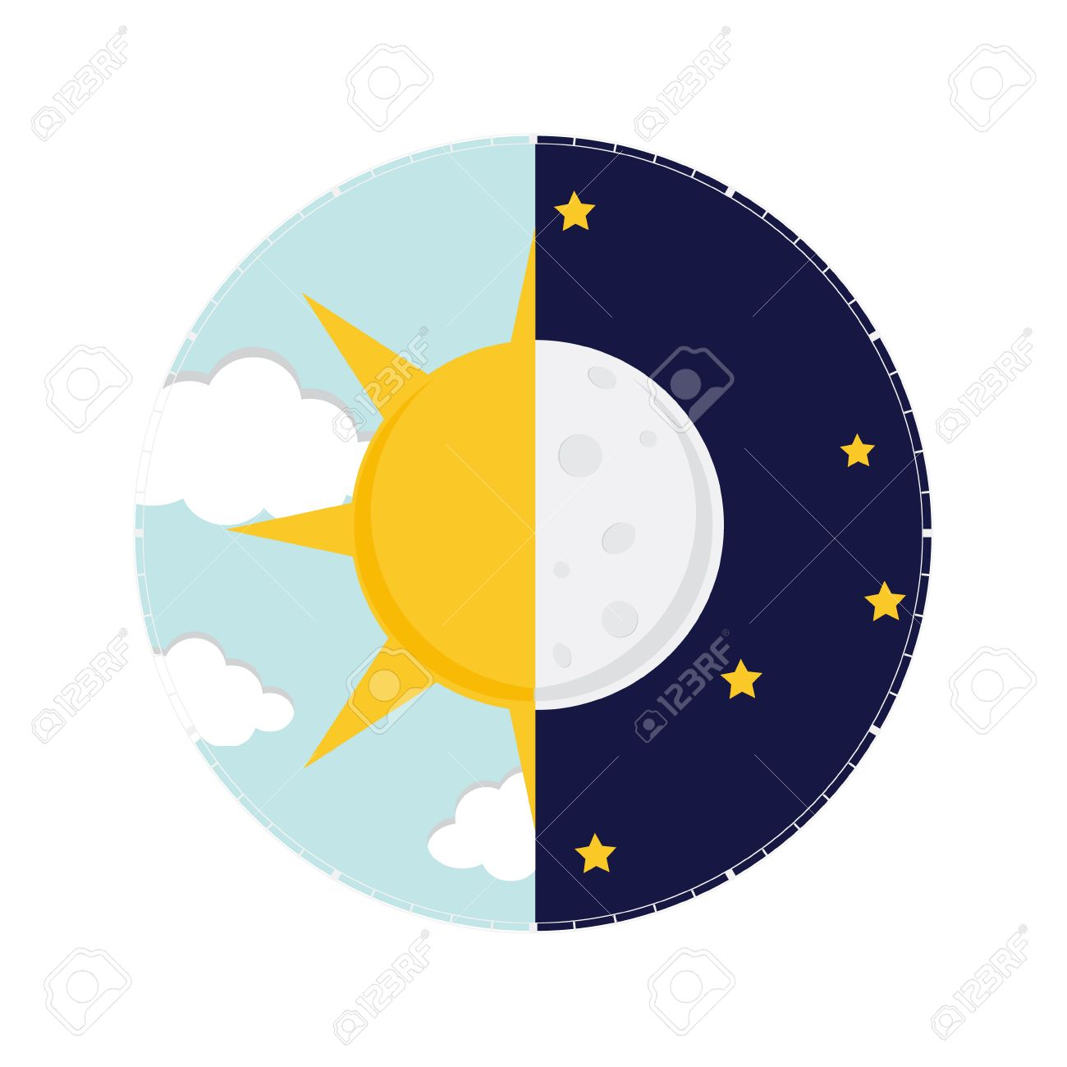
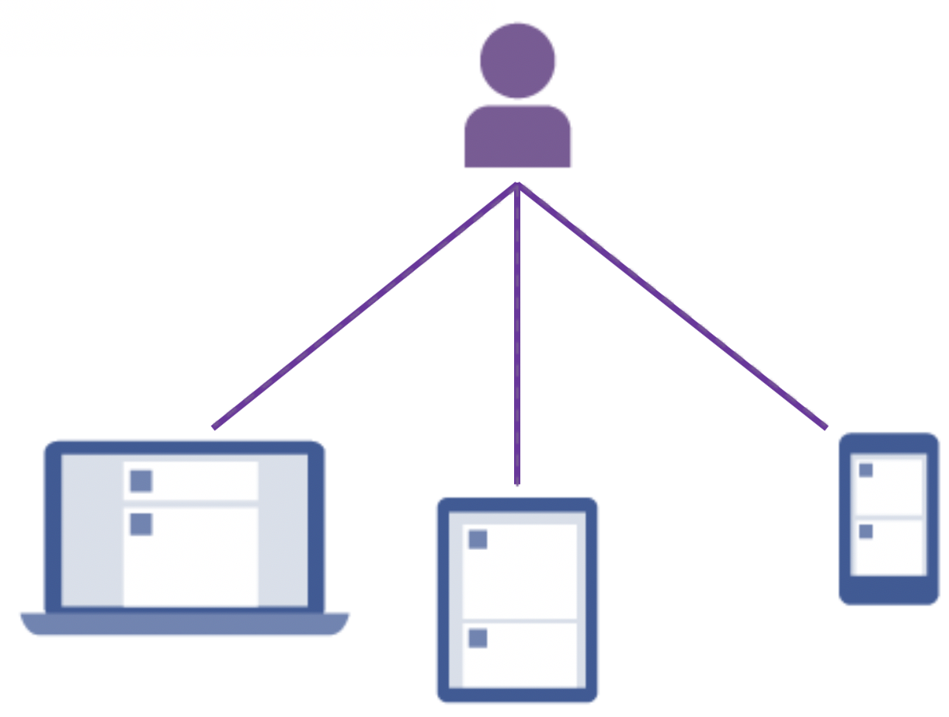
Design Tasks
Focus on intensive screen tasks
Perform less focus intensive tasks on screens
Work at a screen for long periods of time
Learn about digital eye strain
Work at a screen in
various lighting conditions
Work across multiple devices
…
Six Tasks
Notes:
MAX
Focus intensive work at a screen
Not focus sensitive work at a screen
Work for prolonged periods of time
Understand DES/personal symptoms over time
Work in various lighting conditions
Work across many personal/foreign devices
All without experiencing DES symptoms

Slide 6
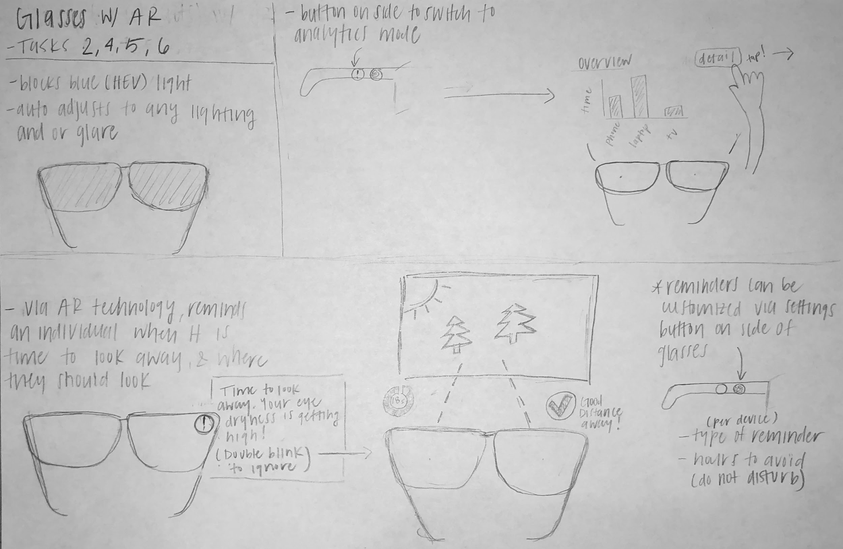
Design 1: Wearable Eyeglasses (AR)
…
3 Design Sketches
Notes:
JULIA (30 sec)

Slide 7
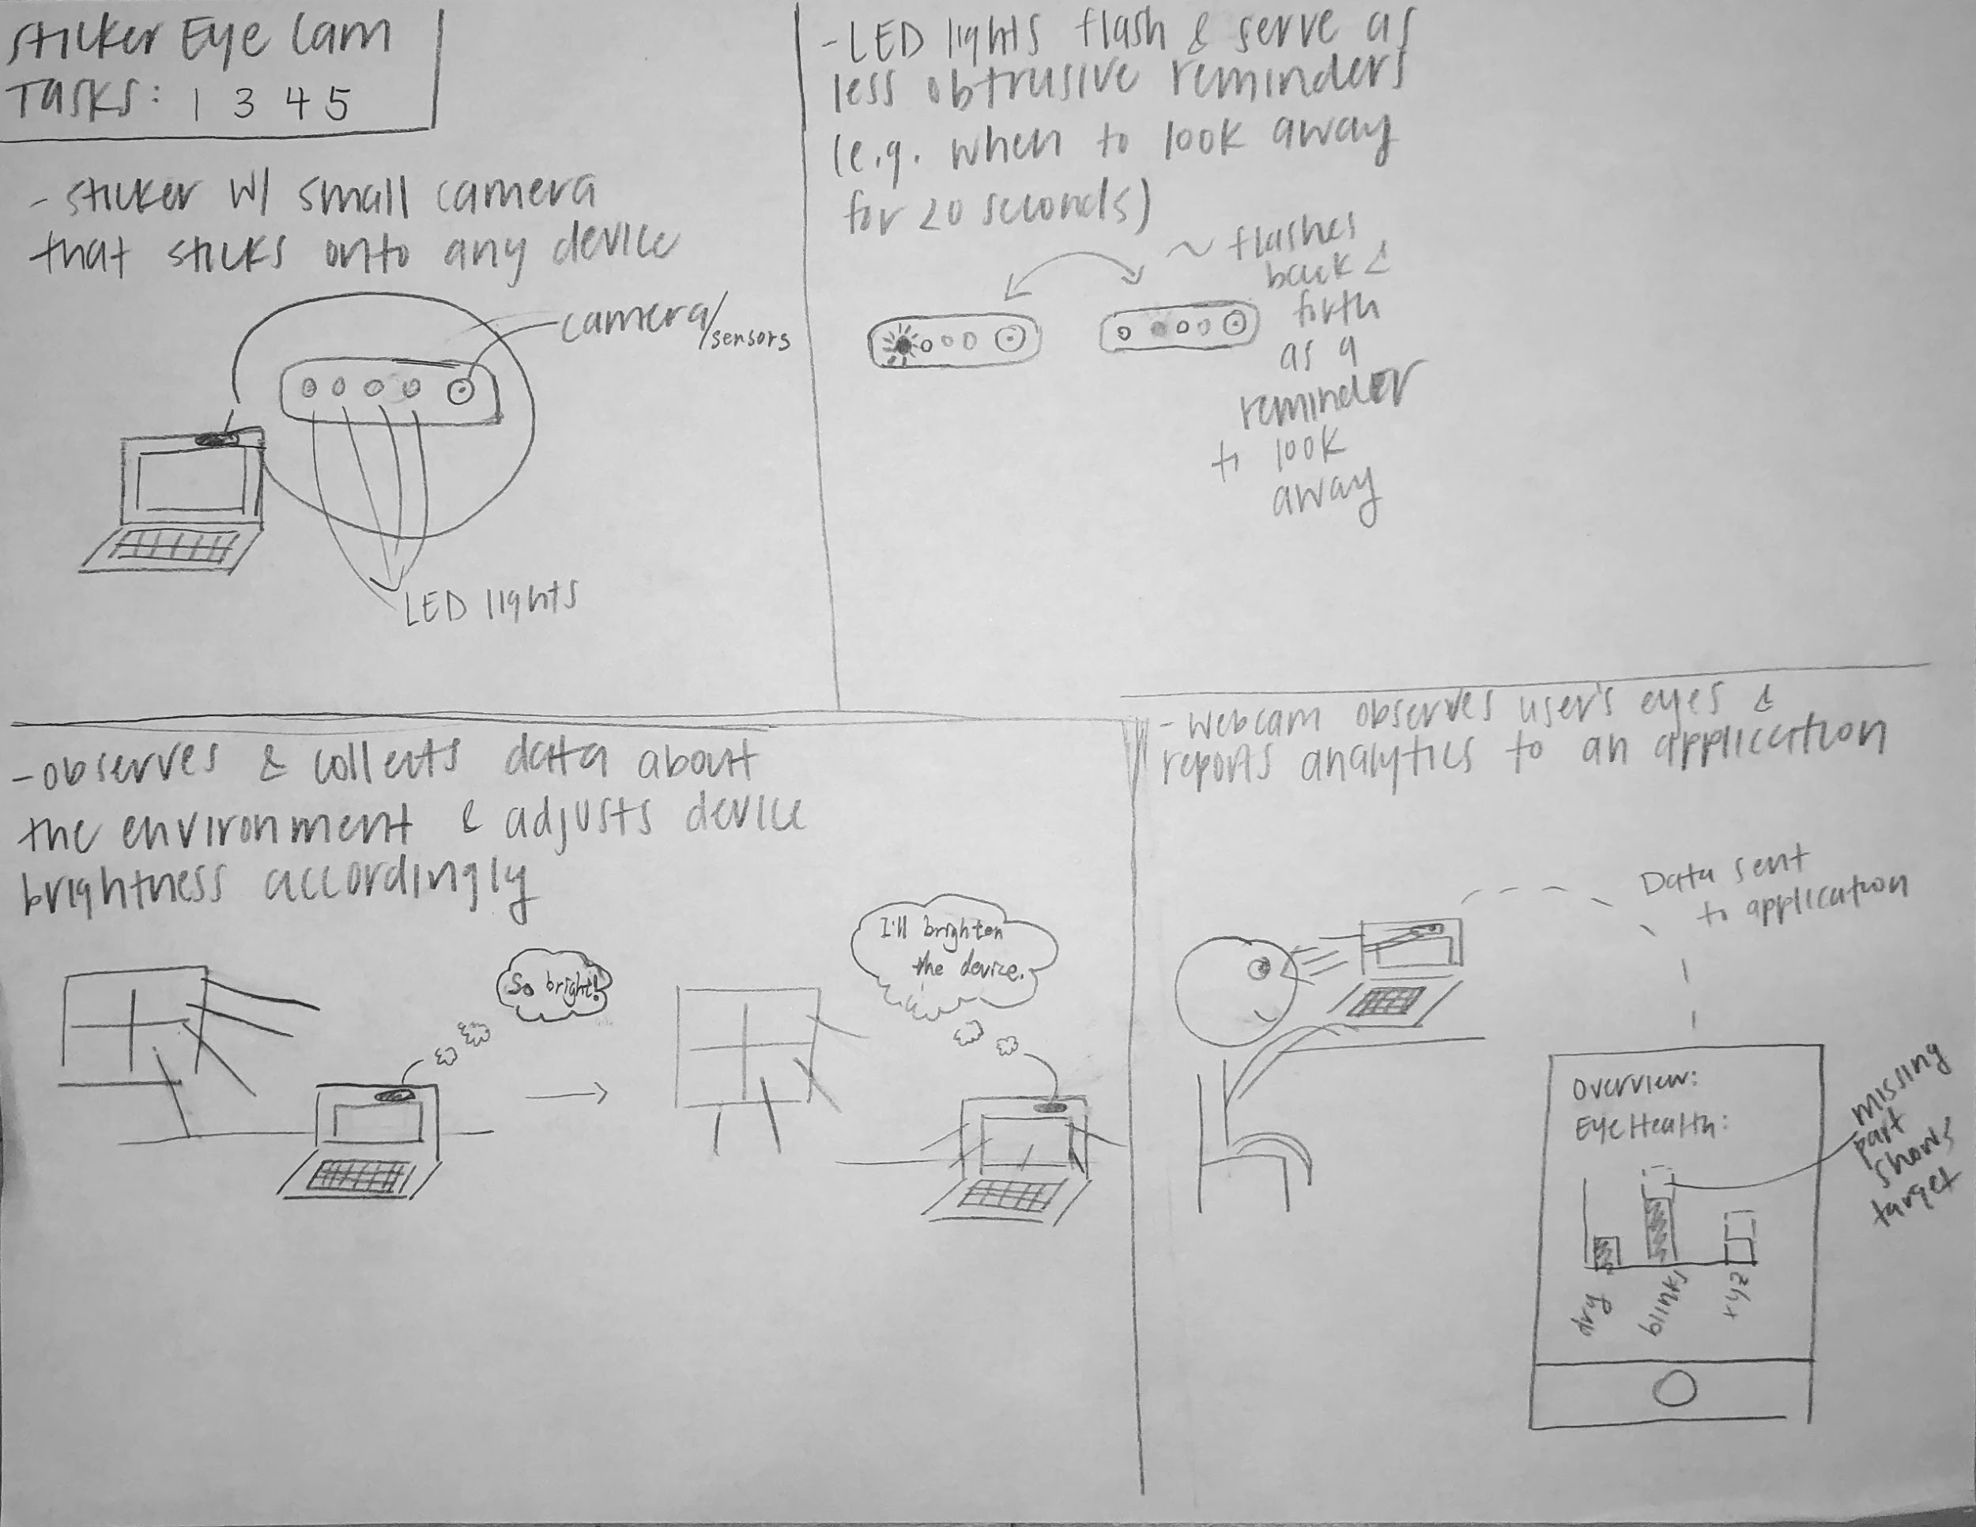
Design 2: Sticker Eye Tracker
…
3 Design Sketches
Notes:
MAX (30 sec)

Slide 8
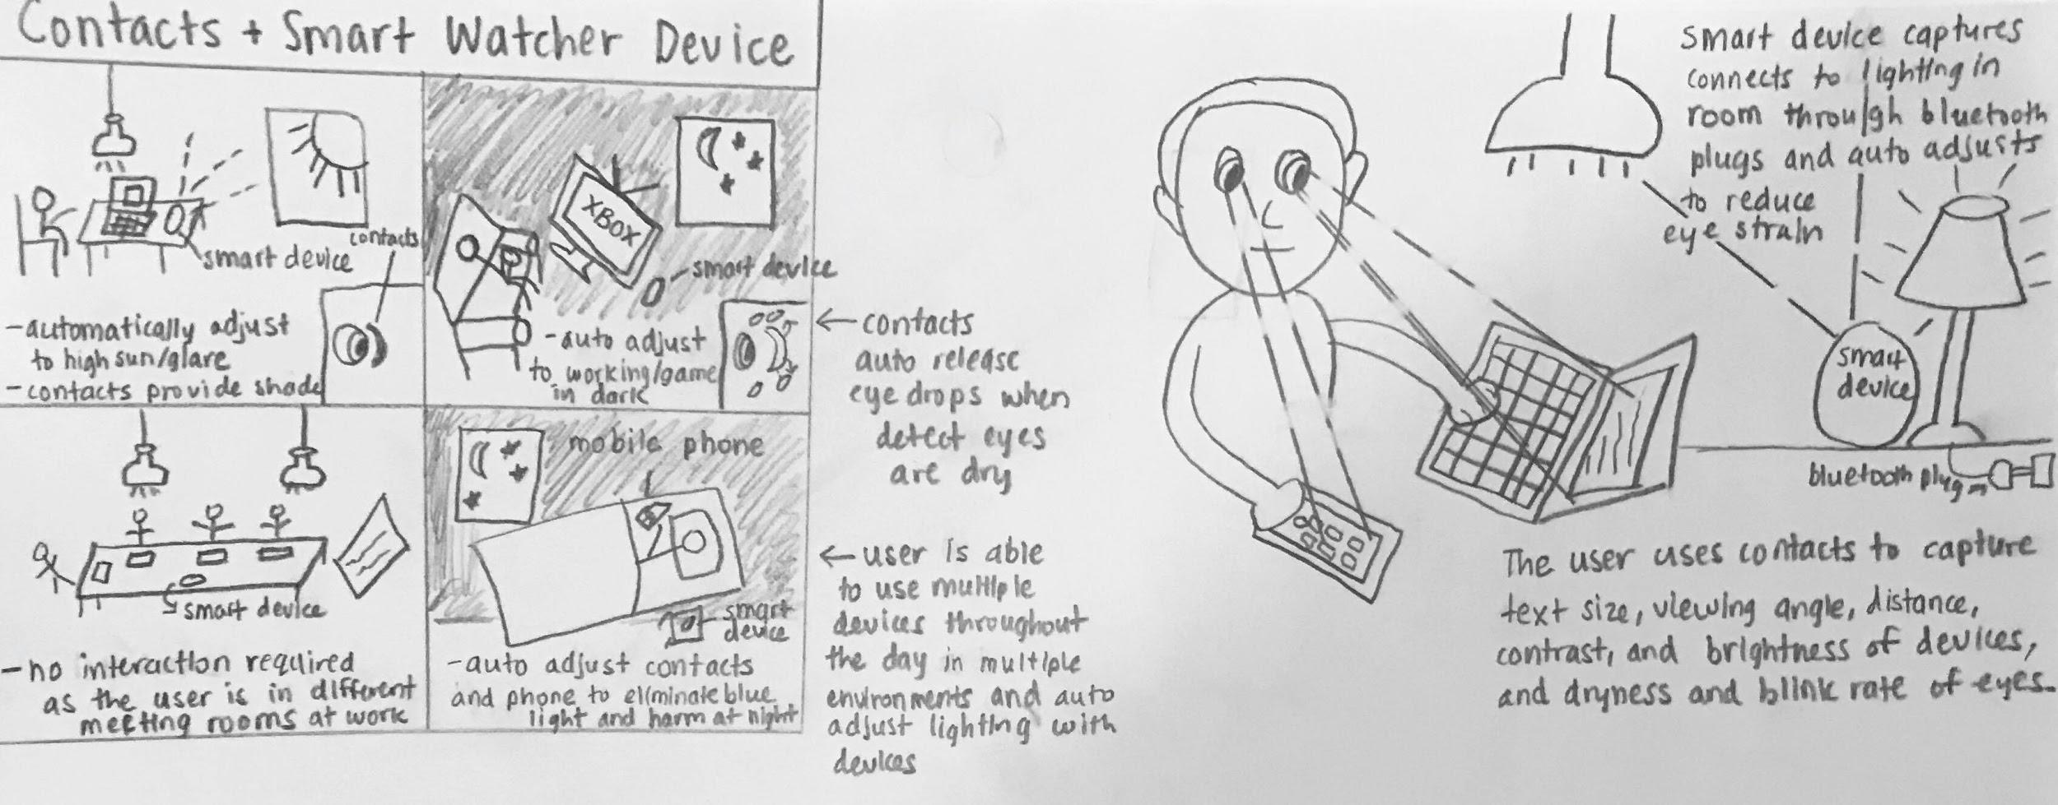
Design 3: Contacts Paired With Smart Watcher Device
…
3 Design Sketches
Notes:
AMY (30 sec)
This design is contacts that provide an unobtrusive way to track eye health and factors of the environment including viewing angle, text size and distance to devices, and brightness and contrast of device in view.
The smart watcher device is a portable device that can be put in any room and connects to the devices and lighting in that room through bluetooth.
This device will measure metrics such as brightness of the surrounding room, and with the information gathered from these devices, the smart watcher device will automatically adjust the brightness of the room and the device currently being used to be the most ideal for reducing digital eye strain supporting task six.
The contacts will also release water into the eyes as it detects eyes are dry, or as prescribed by the eye doctor, and will provide shade to reduce glare and eliminate blue light.

Slide 9



Selected Design - Wearable AR Glasses
Customizable
Portable
Motivational
For a variety of schedules, focus levels, and current eye health
Easy to transfer between various environments
Show analytics of eye health and device usage behaviors to motivate better practices
…
3 Design Sketches
Notes:
MAX (30 sec)

Slide 10
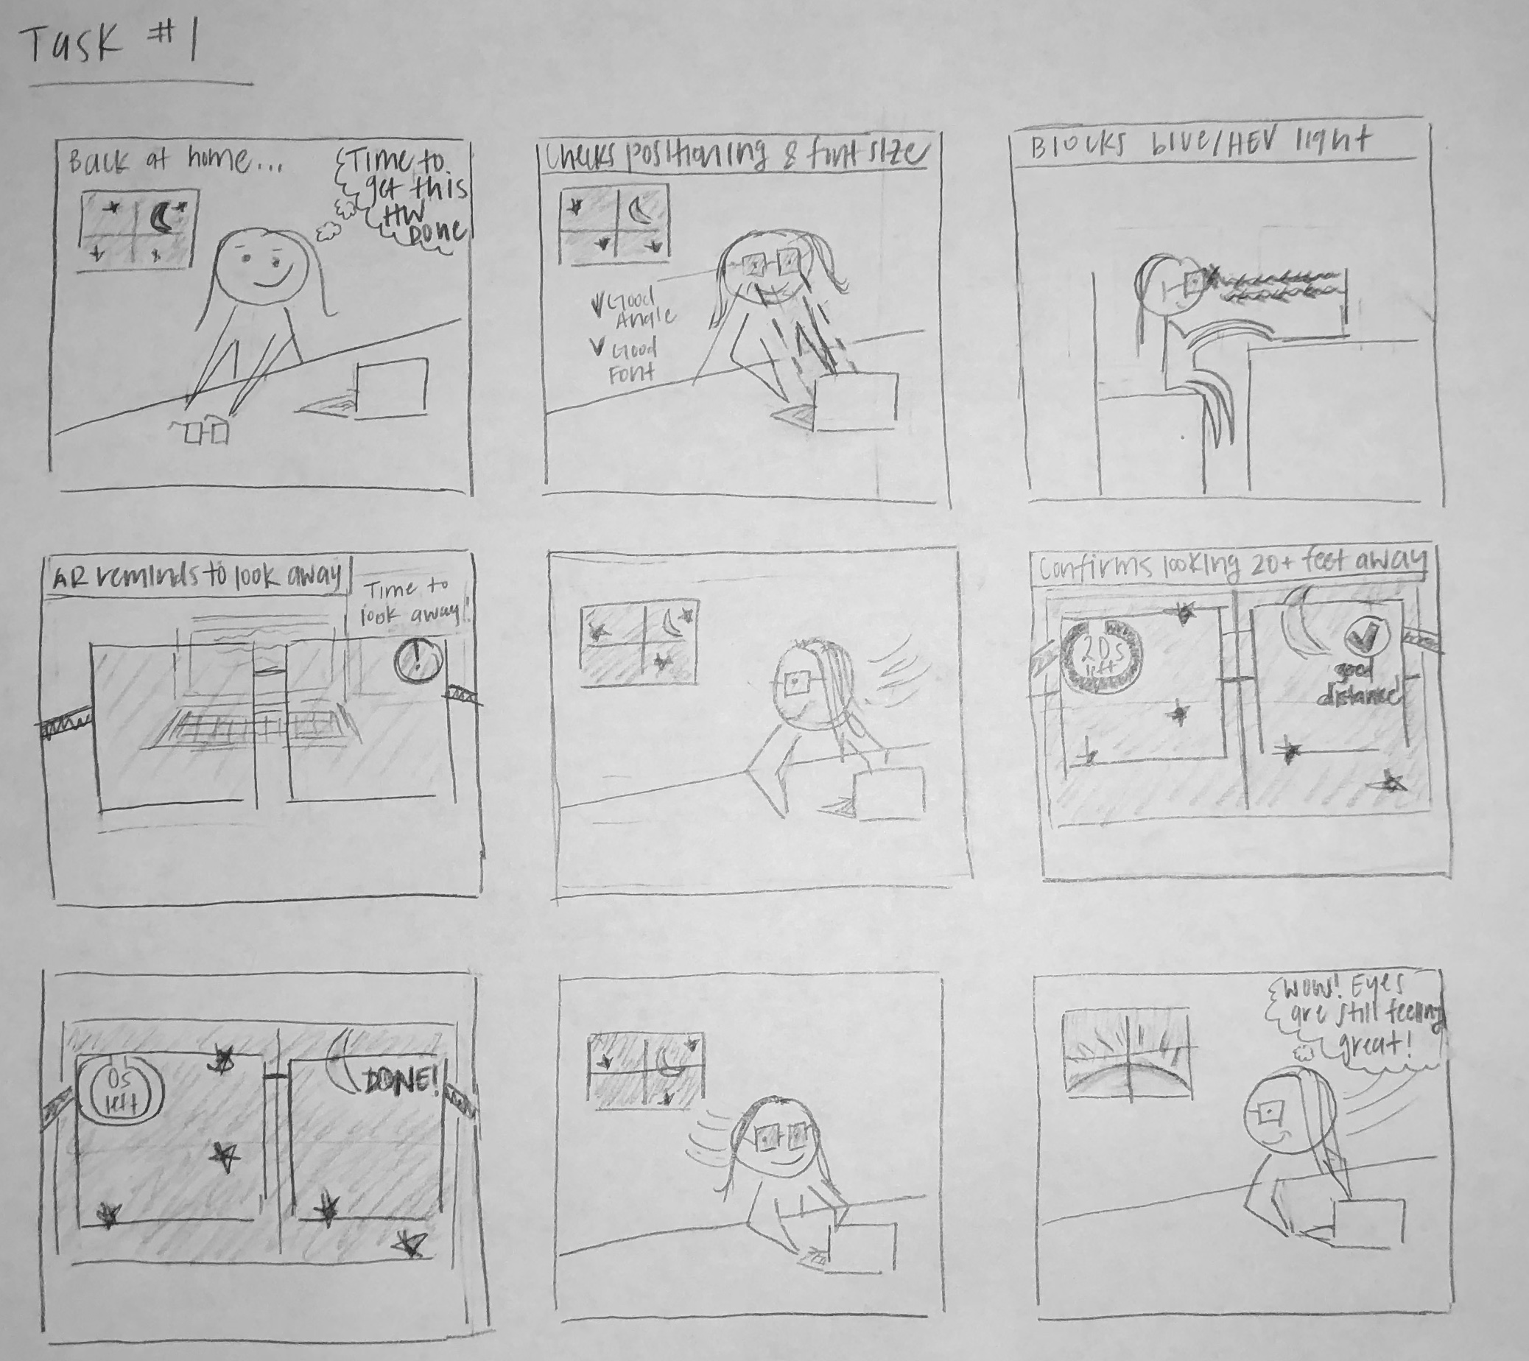
Storyboard #1
Task Description:
Working on a task in a shared space or home for long durations without experiencing DES
Handle variable lighting
Highly customizable
…
Selected Design
Notes:
JULIA (45 sec)

Slide 11
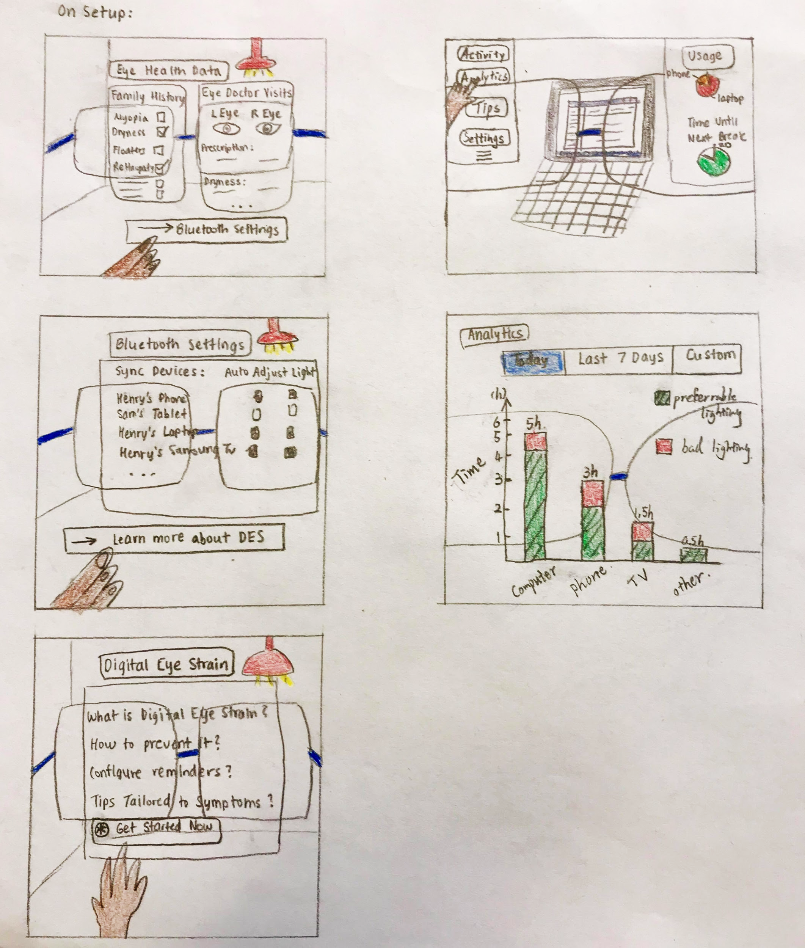
Storyboard #2
Task Description
Educate self about DES
Understand DES symptoms tailored to user eye health
See the progress of these symptoms over time
Monitor Analytics of overall device usage and relative eye health
…
Selected Design
Notes:
AMY (45 sec)
Educate self about digital eye strain, and understand personal digital eye strain symptoms + see the progress of these symptoms over time.
The Left column shows the way in which the AR technology can be set up including part eye health information, connecting to the lights in the nearby environment, and educating oneself about digital eye strain tailored to symptoms that the user has been experiencing.
The right column shows the analytics the user can view regarding their overall device usage and relative eye health.

Slide 12
Lessons Learned in Design Process
Digital eye strain is developed subconsciously
Consideration of other priorities is important
Design needs to be highly customizable
Motivation is needed to incentivize taking action
…
Summary
Notes:
(30 sec)

Slide 13
Thank you

Slide 14
Contribution Statement
Amy Shah: 40%: Laid out presentation, Summarized key points from final project, added storyboards and design sketches.
Max Ding: 30%; Wrote and redesigned 6 tasks and storyboard #2
Julija Pettere: 30%; Wrote out design problem, storyboard #1 and lessons learned, redesigned a couple slides

